Slide 1
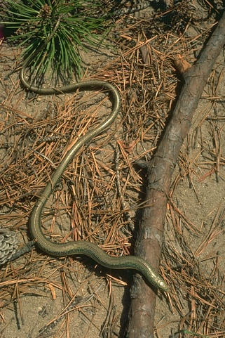
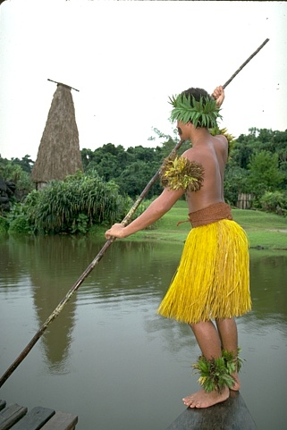
Python code: bitbucket.org/michaelchughes/bnpy
Reliable and scalable variational inference for Bayesian nonparametric models
Michael C. Hughes & Erik B. Sudderth, Brown Univ. Computer Science
Goals
Model Family
Design inference engine for
a broad (but not universal) family of
parametric and nonparametric models
widely used in clustering applications.
scalable – process big data in batches
reliable – find compact, high-quality set of clusters;
avoid local optima
expressive – hierarchical/sequential/spatial structure
cluster
frequency
assignment
indicator
observation
Conjugate
Exponential
Family
cluster
shape
Examples
Mixture Model
Hidden Markov Model
Infinite Relational Model (Kemp et al. ‘06)
+
+
+
+
Topic Model
Hidden Markov Tree
Nested DP (Rodriguez et al. ‘08)
+
+
+
“Topics over Time”
General model composition
HMM with DP mixture emissions
+
+
+
+
dependency
graph
dependency
graph
data
generation
model
+
Scalable Inference
Reliable Inference
Memoized variational algorithm.
process huge data as small, fixed batches
no pesky learning rates
track exact sufficient statistics for entire dataset
(Hughes & Sudderth ‘13)
(Neal & Hinton ’99)
Merge moves for simpler models, faster learning.
Propose candidate model combining two clusters into one
Accept or reject proposal via whole-dataset objective
Construct candidate by simple addition rule
works with
all models!
expected count
of assignments to cluster k
soft assignment probability
of cluster k explaining token n
memoized - compute exactly
stochastic - noisy, biased estimate only
incremental update
soft assignments
statistics follow by additivity
* Not shown:
expected data statistic for cluster k
which can also be incrementally updated
* Birth and delete moves also possible
Image Patches
Topic Models
Easy model comparison on millions of examples.
image-specific cluster frequencies (HDP)
universal cluster frequencies (DP)
Merge/delete moves find compact set of clusters.
Gibbs
final K=67
memoMD
initial K=100 final K=10
(Teh et al. ‘06)
(Bryant et al. ’12)
8x8 patches
from 400 images.
N = 3 million.
learned patch samples
from top 4 HDP clusters
ranked for each image, from shared set of K=200.
Toy Bars. D=1000. 10 true topics.
Wikipedia articles. D=7961.
Results from 1.8 million NY Times articles in paper.

